Slide 1
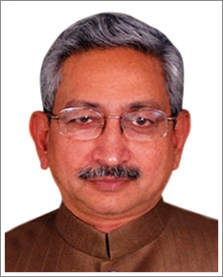
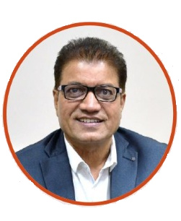
SEM II 2022-23
CRONICAL
Principal: Dr.D.S.Bormane Head of Department.:Dr D V Nighot
From Principal’s Desk:
I‟ m glad to signify that with commencement of this year 2022, AISSMS College of Engineering as completed 27 grand years of its establishment. AISSMS COE as an outcome of academic excellence achieved, is consistently producing University gold medalists and top rankers in different branches of engineering. Faculty is actively involved in research and development. College has number of very high-end analytical, computational and experimental facilities at the disposal of students.
We are going to concentrate more upon the Engineering Research activities and use those for students and society welfare. I am confident that the College is in a position to deliver the best theoretical and practical training to the students and offer the best talent to the employers. I wish all the best to the aspiring students, employers and all other stake–holders in achieving their goals.
Shri Shahu Chhatrapati Maharaj
President, AISSM Society
Awards & Recognition
Awards & Recognition
AISSMS COE
Received
NBA Accreditation
For 6 UG Programs
Dr D V Nighot
Recognition as a Ph.D. Guide(Chemistry) - SPPU Pune
&
Dr. A. B. Patil
Recognition as a Ph.D. Guide(Maths) - SPPU Pune
Published at:
Department of First Year Engineering , AISSMS College of Engineering,
1 Kennedy Road, Pune – 411 001,
www.aissmscoe.com
Editorial Board
Editors:
Dr D V Nighot
Ms. B S Bobdey
Cronical
2022-23

Slide 2
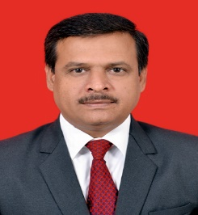
Cronical
From HOD’s Desk…
First Year Engineering plays a pivotal role in ushering the students to be a prospective engineer. The department nurtures and molds the students to enter in the rapid fast changing pragmatic world yet maintaining the sensitivity in them. The teaching-
learning methodology used by staff boosts the students thinking potential and lifts their critical analyzing skills. As most of the students come from the diversified social environment it becomes a need for the department that they are mentored by the staff with whom they can share their thoughts, expectations, express themselves and would feel comfortable away from home. we as the department is the family of 33 faculty and 5 supporting staff for 11 divisions each with 60 students. The department has a well qualified and experienced staff that is always on their toes. The faculties have excellent academic records and are highly regarded amongst students. The various subjects offered to students in First Year, though common to all branches, essentially lays a strong foundation to emerge as a potential engineer. Hence, our self-motivated staff wholly dedicated to the first year department, do their best and try to make the subjects simple and interesting.
Associate Professors – 04 Assistant Professors – 29 Supporting Staff – 05
List of Toppers SEM-II
SR. NO. | DIVISION | NAME OF STUDENT | SGPA
1 | COMP-B | MUSALE SHUBHAM SANJAY | 9.41
2 | COMP-B | SONI SIDDHI SACHIN | 9.27
3 | COMP-A | GHUGE SARTHAK RAMDAS | 9.18
4 | COMP-B | SHARMA MANGALAM SACHIN | 9.16
5 | COMP-A | BHAREKAR ROHAN RAMCHANDRA | 9.14
6 | COMP-A | GAIKWAD SHIVTEJ SUNIL | 9.14
7 | COMP-B | SARVAIYYA PRIYANSHU MANOJ | 9.11
8 | COMP-B | VAISHNAVI DEVIDAS SHEVATE | 9.07
9 | COMP-B | SURYAWANSHI YASH ZUMBARSING | 9.07
10 | MECH-B | WAWARE ARYAN AJAY | 9.02
From Editors Desk….
It gives us great pleasure to hand over to you “Chronicle” the newsletter of First Year engineering department. The Department of First Year Engineering has a total intake of 660 students, diversified in 8 different branches of Engineering. The present era and the challenging future, demands strong basic technical knowledge and continuous growth of engineering students on all facets. Therefore the department is bestowed with highly qualified and experienced faculty members with specialization in various disciplines of engineering and sciences. Also the behavioral changes found in the today‟s youngsters give rise to the need of continuous assistance and counseling for their professional and personal growth. First year department considers all the needs and requirements of the current generation and gives its best for their overall development. Hope you will find this newsletter informative. Your suggestions for improvement in the newsletter are welcome.
Cronical
2022-23

Slide 3
Cronical
FDP/STTP ATTENDED BY THE DEPARTMENT FACULTY
Sr. No. | Name of Faculty | Title of the FDP/STTP | Organized by | Duration/ Dates
1 | Almas Ambreen | Recent Trends in Advance in Electronics | Poornima institute of engineering and Technology Jaipur | 10-14 April 2023
2 | Dr. P. D. Baviskar | AI/ML | MIT College Pune | 17-18 May 2023
3 | S A Kothari | Recent Trend in Machine Learning | Department of E and Tc AISSMS COE Pune | 13-17 March 2023
4 | S A Kothari | NATIONAL INTELLECTUAL PROPERTY AWARENESS MISSION | Intellectual Property Office and MoE's Innovation Cell, India | April 12,2023
5 | S A Kothari | Innovation Ambassador(IA)training foundation level | MoE's Innovation Cell, India and AICTE | Total 15 sessions
6 | S A Kothari | Innovation Ambassador(IA)training Advanced level | MoE's Innovation Cell, India and AICTE | Total 15 sessions
7 | B S Bobdey | Recent Trend in Machine Learning | Department of E and Tc AISSMS COE Pune | 13-17 March 2023
8 | KG Choudhari | Innovative teaching and Online Resources | IOT Academy Tamilnadu | 7th to 8th April 23
9 | KG Choudhari | Innovative teaching and Learning Pedagogy | Research Foundation of India And RFI-Care | 26th june to 30 june 23
10 | KG Choudhari | "ght and Research Publication, CopyriPatents in Science and Technology" | P. R. Pote Patil College of Engineering & Management, Amravati. | 3rd to 7th July 23
11 | S.T.Surase | Mathematics behind AI/ML | MIT Alandi | 17-18 may-2023
12 | S.T.Surase | Research Publication, Copyright Patents in | P. R. Pote Patil College of Engineering & Management, Amravati. | 3rd to 7th July 23
13 | Dr M K Nikam | TWO - WEEK REFRESHER COURSE IN “MATHEMATICS | Teaching Learning Centre Ramanujan College, University of Delhi | 29 / 04/ 2023 to 13/05/2023
Cronical
2022-23

Slide 4
Cronical
FDP/STTP ATTENDED BY THE DEPARTMENT FACULTY
Sr. No. | Name of Faculty | Title of the FDP/STTP | Organized by | Duration/ Dates
14 | Dr M K Nikam | Two days’ National Level FDP on “Mathematics Behind AI/ML” | School of Humanities and Engineering Sciences, MIT Academy of Engineering, Alandi, Pune | 17-18 May 2023
15 | Dr. A. B. Patil | Two days’ National Level FDP on “Mathematics Behind AI/ML” | School of Humanities and Engineering Sciences, MIT Academy of Engineering, Alandi, Pune | 17-18 May 2023
16 | V R Patil | Thermal Engineering -Basic and Applied | IIT Madras | Jan 23 to April 23
17 | S H Lavate | Faculty Development Program on "Emerging Trends in 5G Technology-Enabled Education | Electronics and Telecommunication Department ,Technically Co-Sponsored by Pune Management Association(PMA) | 02/05/2023 to 04/05/2023
18 | Dr. P. D. Baviskar | FDP on AI and ML | organized by the School of Humanities and Engineering Sciences, MIT Academy of Engineering, Alandi, Pune | 17th-18th May 2023.
CONFERENCES ATTENDED BY THE DEPARTMENT FACULTY
Sr No | Name of Faculty | Title of the Conference / Symposium | Organized By | Duration/ Dates
1 | Bhakti Patil | International Conference On Green Energy 2023 | AISSMSCOE | 16 and 17 May 2023
2 | Bhakti Patil | National Conference on Innovations in Engineering and Technology 2023 | AISSMSCOE | 31/05/2023
3 | Ankita Gupta | International Conference On Green Energy 2023 | AISSMSCOE | 16 and 17 May 2023
4 | Dr. P. D. Baviskar | International Conference On Green Energy 2023 | AISSMSCOE | 16 and 17 May 2023
Cronical
2022-23

Slide 5
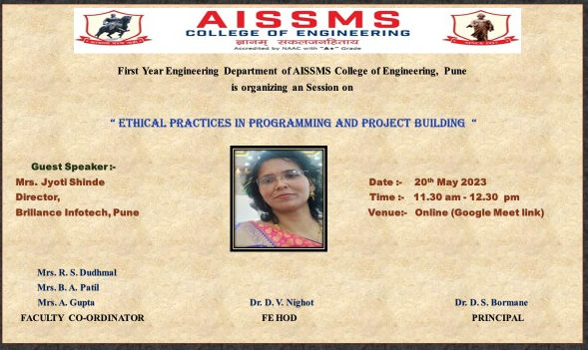
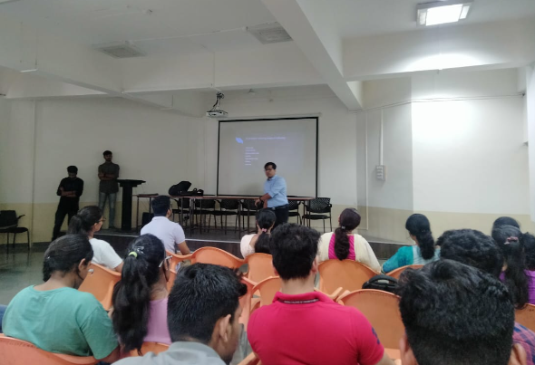
Cronical
FDP/STTP ATTENDED BY THE DEPARTMENT FACULTY
S N | Name of faculty coordinator | Topic | Name and contact details of guest | Date | Number of beneficiaries
1 | Mrs.Bhakti Patil and Mrs.Ankita Gupta | Guest Lecture for FE students on Project Based Learning | Mr.Akshay Ugale, Senior Machine Learning Consultant, StatusNeo | 12/04/2023 | 48
2 |  | Expert Lecture on “Ethical Practices in Programming and Project Building” for FE students | Mrs.Jyoti Shinde. Director , Brilliance Infotech Pune | 20/05/2023 | 93
Expert Lecture on “Ethical Practices in Programming and Project Building” for FE students
Guest Lecture for FE students on Project Based Learning
Cronical
2022-23

Slide 6
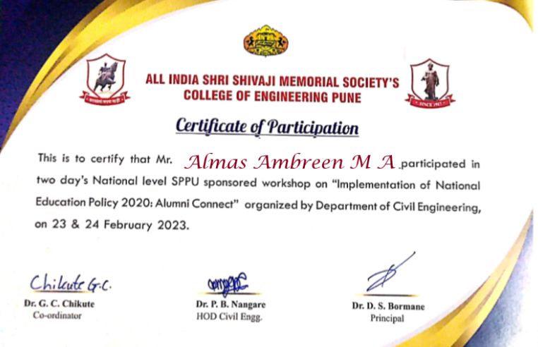
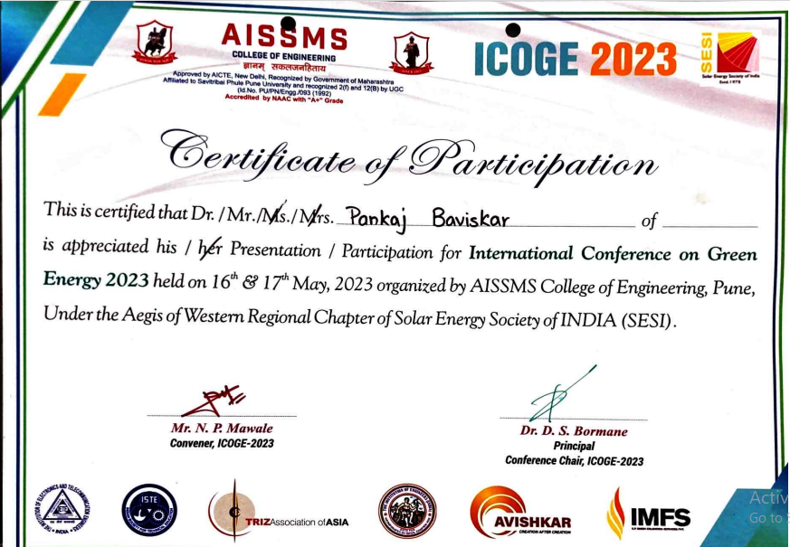
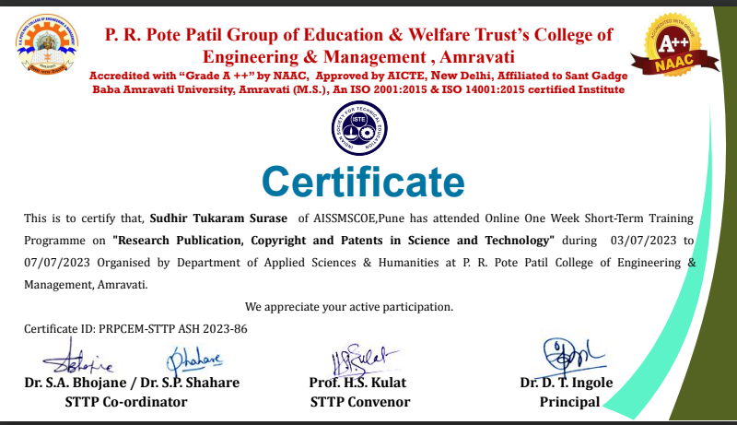
Cronical
SEMINARS/ WORKSHOPS/ WEBINARS Attended BY THE DEPARTMENT FACULTY
S. No. | Name of Faculty | Title of the Seminar/Webinar | Organized by | Duration/ Dates
1 | Almas Ambreen | Implementation of national educational policy | Department of Civil Engineering AISSMS COE Pune | 23-24 February 2023
2 | S.B.Patil | Health Monitoring of concrete structure | UltraTech Cement | April 22 ,2023
3 | S A Kothari | Remaining life analysis for an uninterrupted structural performance | UltraTech Cement | 20 May 2023
4 | S A Kothari | Building products for building solutions | UltraTech Cement | 29 April 2023
5 | S A Kothari | Seismic retrofitting of reinforced concrete buildings | UltraTech Cement | 17 June 2023
6 | S H Lavate | Webinar on 5G Course and establishment of use case Labs in Engineering Institutions | Skill Development Unit, Department of Telecommunication, New Delhi | 19/04/2023
Cronical
2022-23

Slide 7
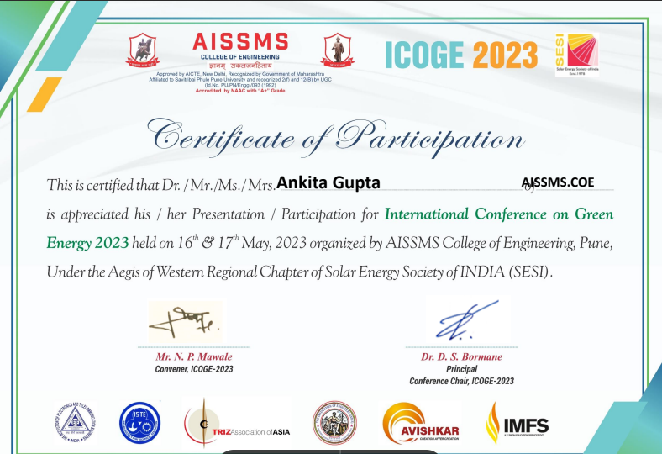
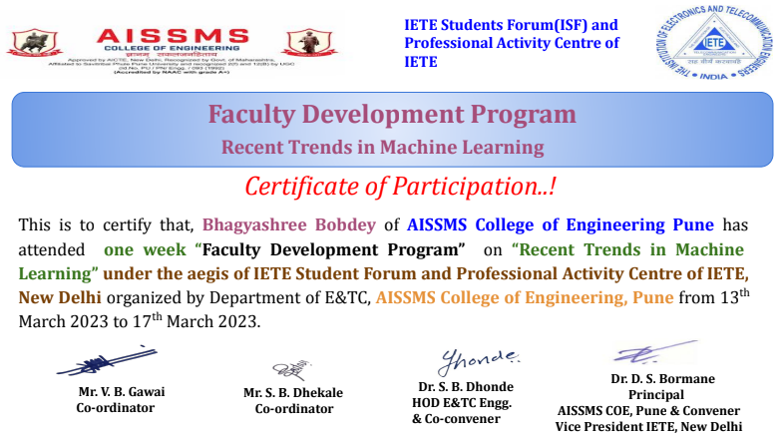
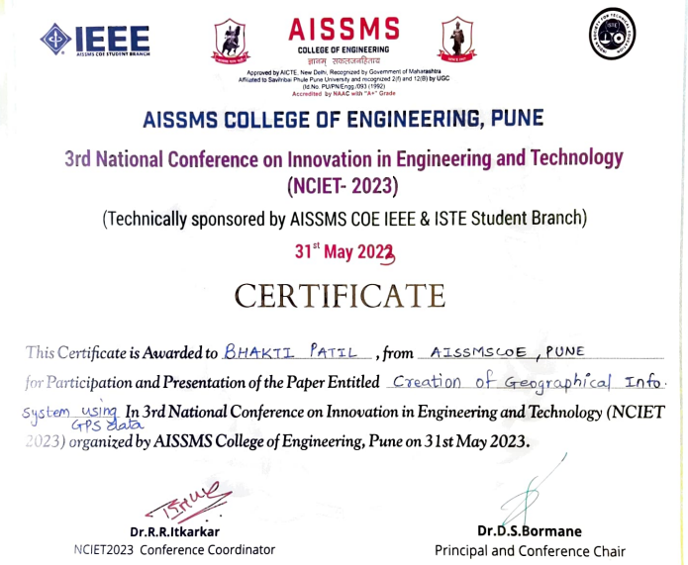
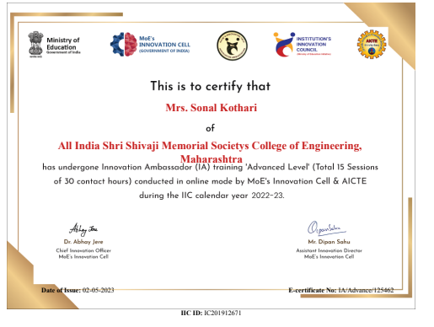
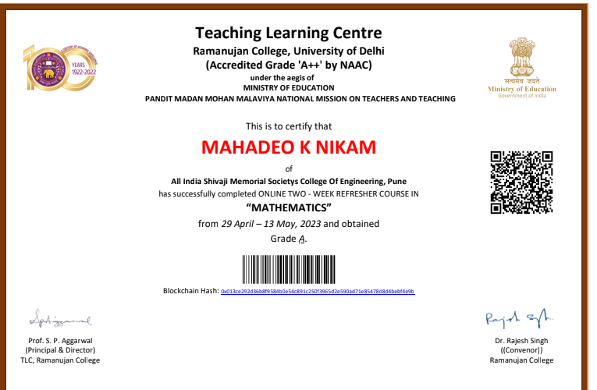
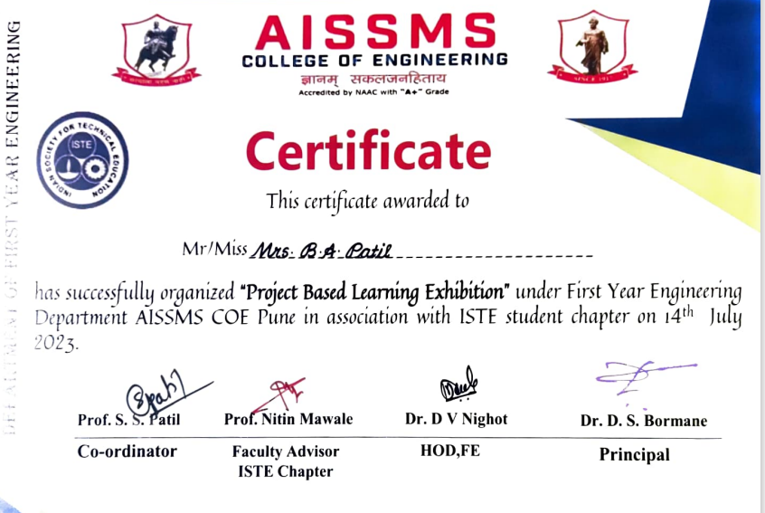
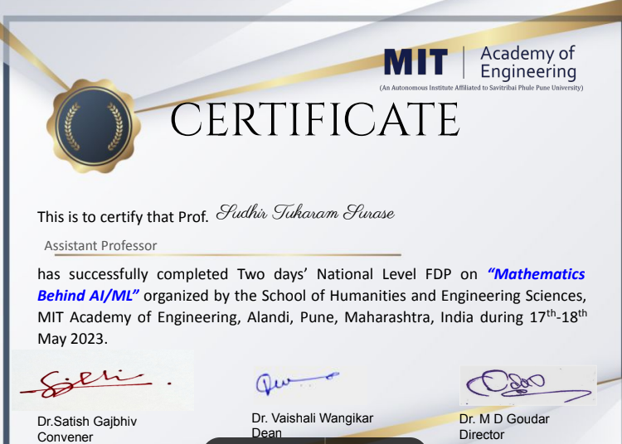
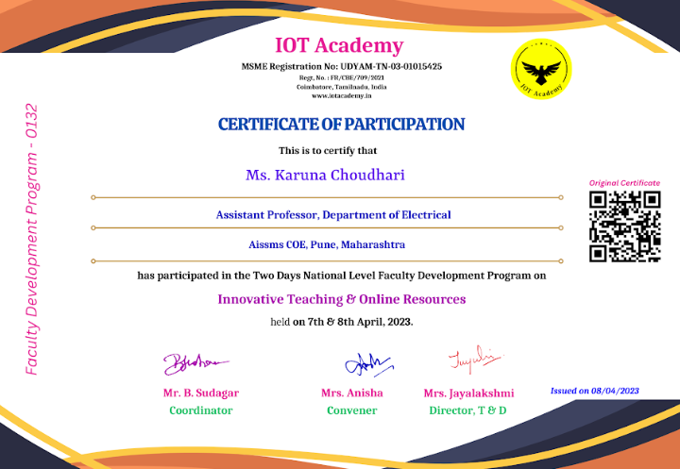
FDP /STTP ATTENTED BY FACULTY
Cronical
Cronical
2022-23

Slide 8
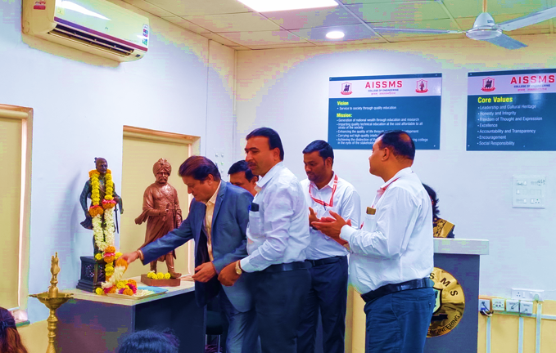
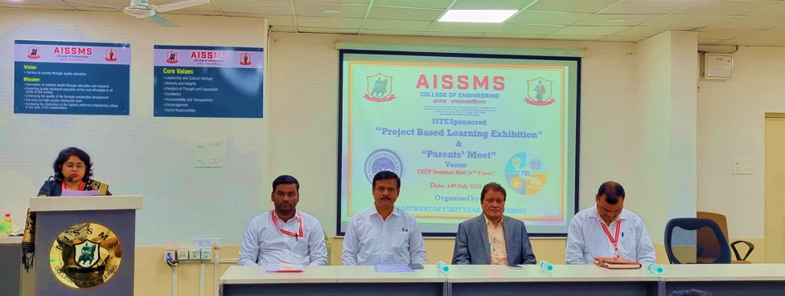
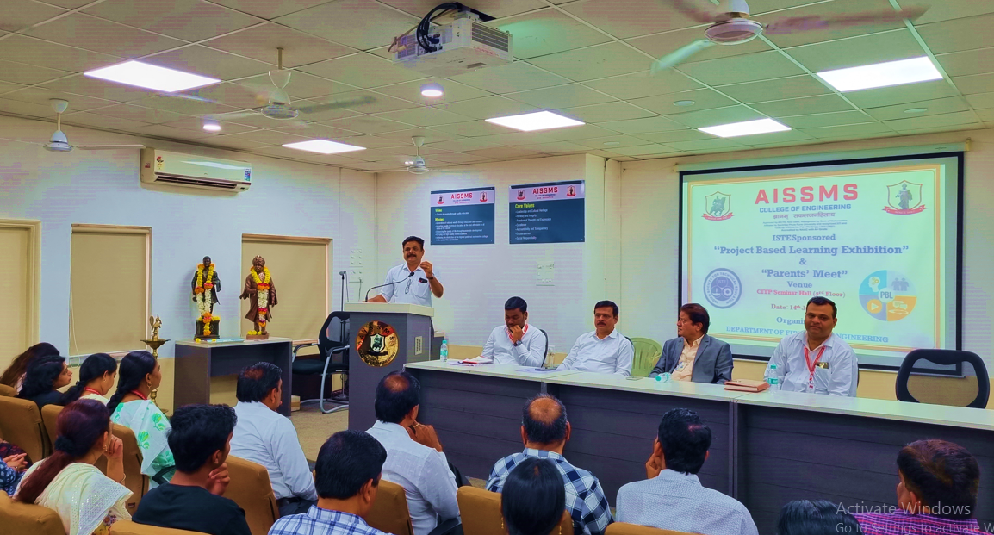
Cronical
Parent’s Meet
Parents’ Meet Inaugurated by
AISSMSCOE -Principal Dr D S Bormane
FE HOD
Dr D V Nighot
Parent
Mr Kale
(F/o Atharva Kale)
ISTE Co-ordinator
Asst Prof N P Mavale
PBL Co-ordinator
Asst Prof S S Patil
Anchoring by
Asst Prof Ms M A D’cruz
Gathering Addressed by
Mr Gosavi
(F/o Sukalp Gosavi)
Cronical
2022-23

Slide 9
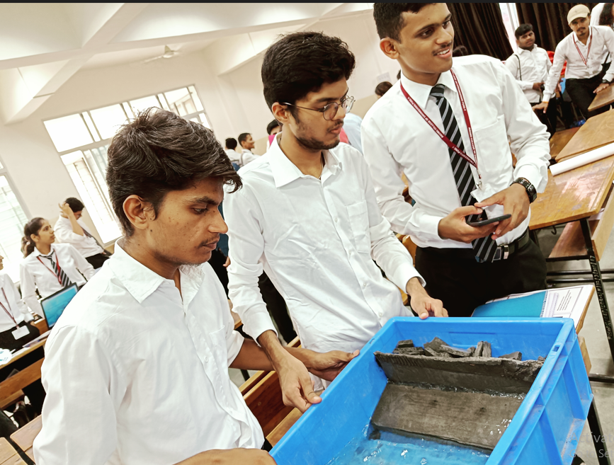
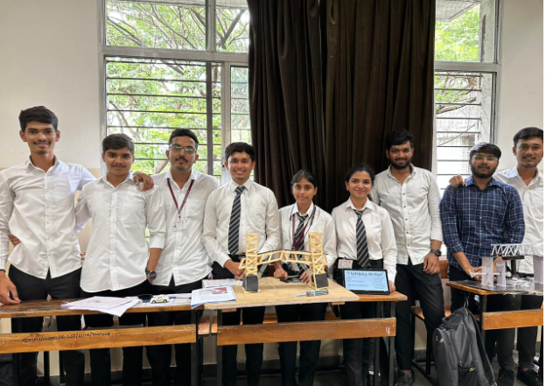
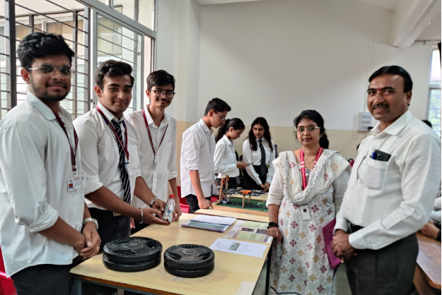
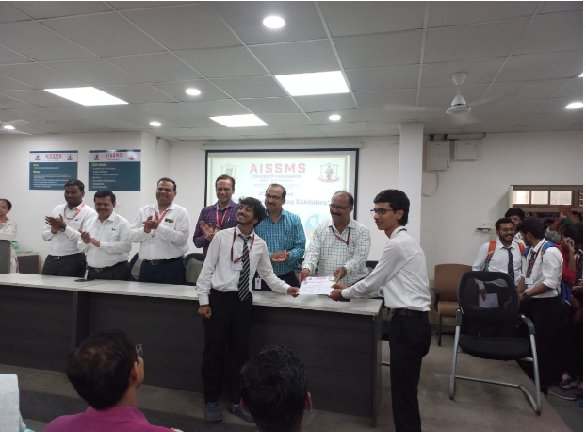
Cronical
PBL EXHIBITATION
The department of First Year Engineering has taken initiative to organise a Project Base Learning for all first-year engineering students. Also, on same day FE parents meet was conducted with the presence of 40 parents. This event was coordinated by Prof. S.S Patil (PBL Coordinator), Dr.D.V Nighot (Head of Department )
Winners of PBL Exhibition
Sr.No. | Rank | Prize (Rs.) | Project Title | Name of Winner
1 | First | 3000/- | Water Level Indicator | Kunal & team
2 | Second | 2500/- | Pune Metro Project | Siddhi Darwatkar & team
3 | Third | 2000/- | Cigarette Management | Atharva Kahire & team
4 | Fourth | 1500/- | Tsunami Wave | Parth Jaiswal & team
5 | Fifth | 1000/- | Ardunio Based Robot | Pratik Walunj & team
Cronical
2022-23

